Slide 1
MALIGNANT COMMENTS CLASSIFIER PROJECT
SUBMITTED BY,
Roshan Kumar Verma

Slide 2
INTRODUCTION
Our goal is to build a prototype of online hate and abuse comment classifier which can used to classify hate and offensive comments so that it can be controlled and restricted from spreading hatred and cyberbullying.
The proliferation of social media enables people to express their opinions widely online. However, at the same time, this has resulted in the emergence of conflict and hate, making online environments uninviting for users. Although researchers have found that hate is a problem across multiple platforms, there is a lack of models for online hate detection.
Online hate, described as abusive language, aggression, cyberbullying, hatefulness and many others has been identified as a major threat on online social media platforms. Social media platforms are the most prominent grounds for such toxic behavior .
There has been a remarkable increase in the cases of cyberbullying and trolls on various social media platforms. Many celebrities and influences are facing backlashes from people and have to come across hateful and offensive comments. This can take a toll on anyone and affect them mentally leading to depression, mental illness, self-hatred and suicidal thoughts.
Internet comments are bastions of hatred and vitriol. While online anonymity has provided a new outlet for aggression and hate speech, machine learning can be used to fight it. The problem we sought to solve was the tagging of internet comments that are aggressive towards other users. This means that insults to third parties such as celebrities will be tagged as offensive, but “u are an idiot” is clearly offensive.

Slide 3
DATA SOURCES AND THEIR FORMATS
The data set contains the training set, which has approximately 1,59,000 samples and the test set which contains nearly 1,53,000 samples. All the data samples contain 8 fields which includes ‘Id’, ‘Comments’, ‘Malignant’, ‘Highly malignant’, ‘Rude’, ‘Threat’, ‘Abuse’ and ‘Loathe’.
The label can be either 0 or 1, where 0 denotes a NO while 1 denotes a YES. There are various comments which have multiple labels. The first attribute is a unique ID associated with each comment.
This project is more about exploration, feature engineering and classification that can be done on this data. Since the data set is huge and includes many categories of comments, we can do good amount of data exploration and derive some interesting features using the comments text column available.
The Data set includes :-
Malignant: It is the Label column, which includes values 0 and 1, denoting if the comment is malignant or not.
Highly Malignant: It denotes comments that are highly malignant and hurtful.
Rude: It denotes comments that are very rude and offensive.
Threat: It contains indication of the comments that are giving any threat to someone.
Abuse: It is for comments that are abusive in nature.
Loathe: It describes the comments which are hateful and loathing in nature.
ID: It includes unique Ids associated with each comment text given.
Comment text: This column contains the comments extracted from various social media platforms.

Slide 4
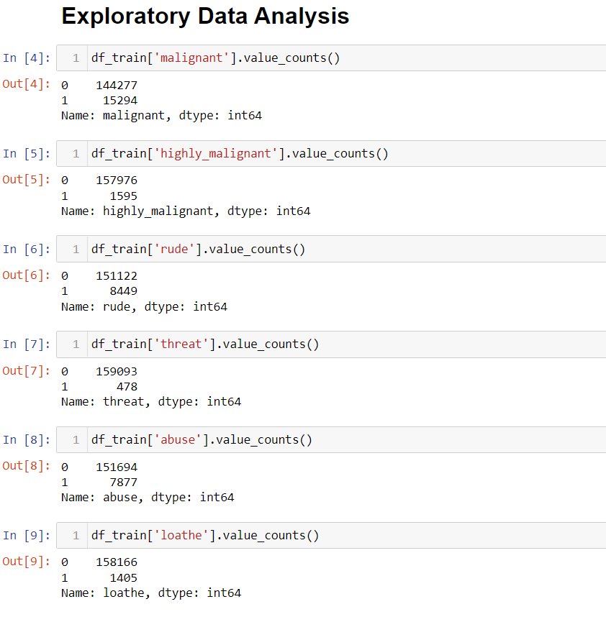
Exploratory Data Analysis
Checking the value counts of the features
From the this observations, we can see that its an imbalanced dataset and we need to handle them

Slide 5
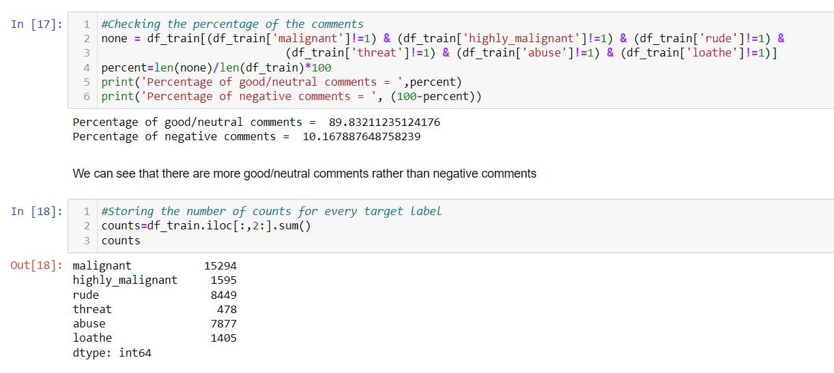
Analytical Problem
So, only 10% of the data is getting classified as malignant comments data is unbalanced.
We can see that there are more good/neutral comments rather than negative comments

Slide 6
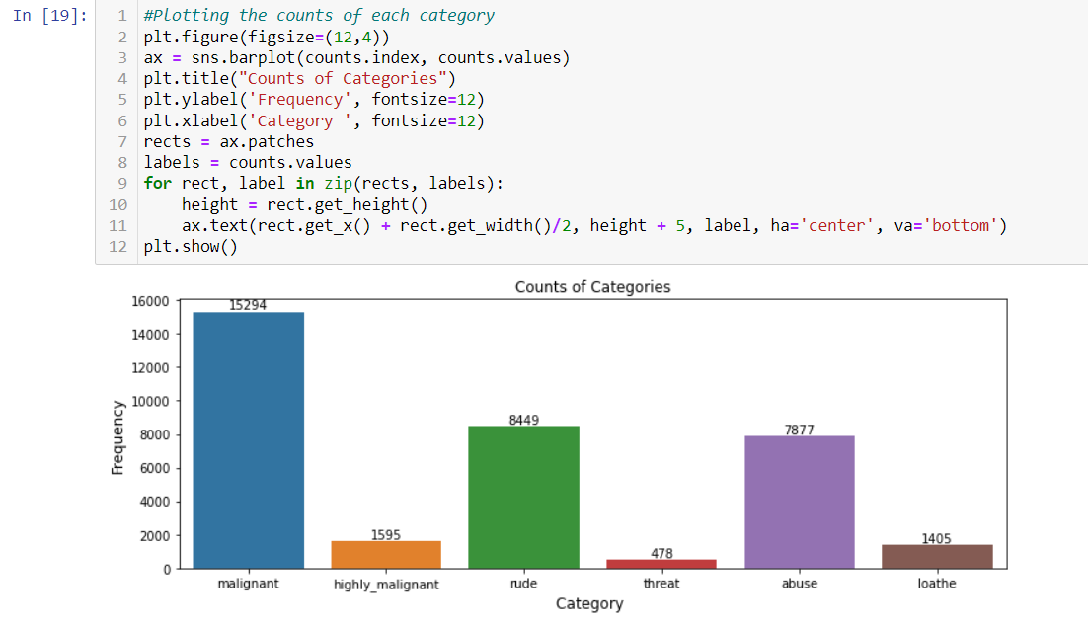
Analytical Problem
Malignant comments are the highest among all whereas threat comments are very less. Rude and abuse comments are also present more

Slide 7
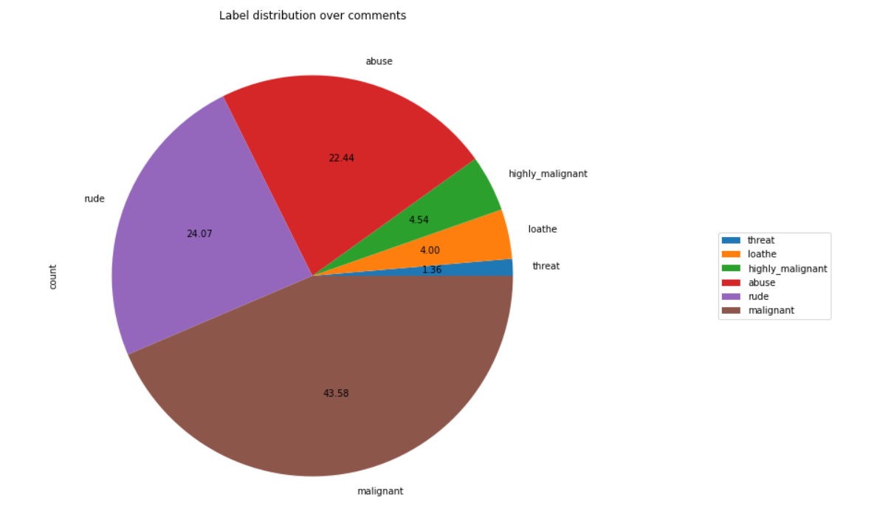
Analytical Problem
As we see above malignant, and rude sentence are high classified and threat, loathe are least classified.

Slide 8
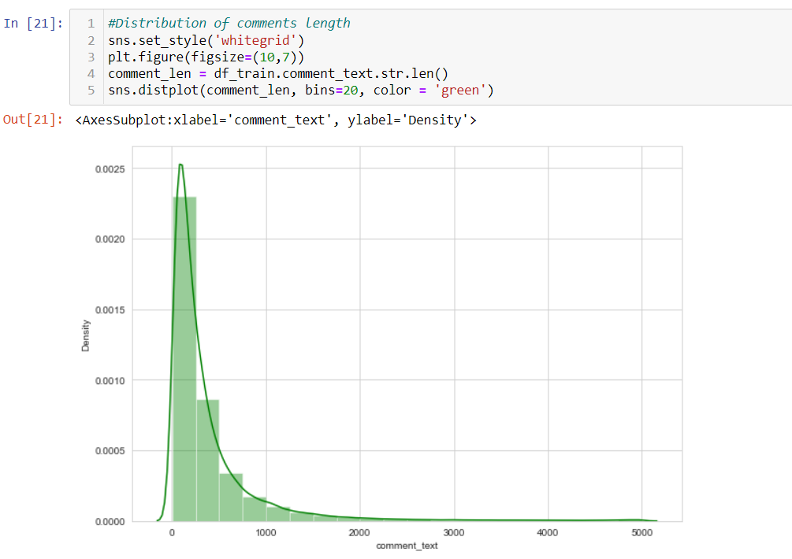
Analytical Problem
Above is a plot showing the comment length frequency. As noticed, most of the comments are short with only a few comments longer than 1000 words. Majority of the comments are of length 500, where maximum length is 5000 and minimum length is 5. Median length being 250.

Slide 9
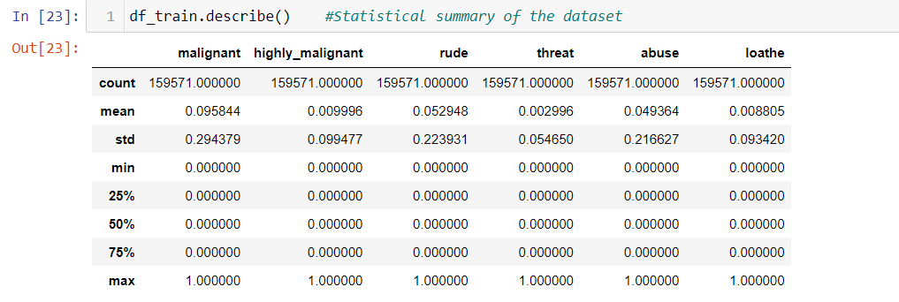
Analytical Problem
The minimum value and the maximum value of the attributes is same i.e., 0 and 1 respectively.
The mean and standard deviation is nearly 0-1 of all the attributes in the training dataset.
Here, with this statistical analysis, it is interpreted that there are no outliers as well as skewness present in this training dataset.
The count of each field is equal which shows that there are no missing values present.

Slide 10
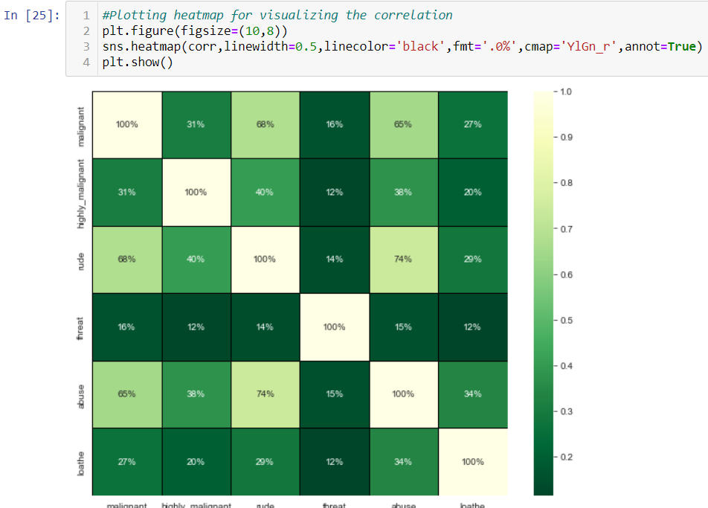
Analytical Problem
The highest positive correlation is seen in between fields 'rude' and 'abuse'.
Attribute 'threat' is negatively correlated with each and every other feature of this training dataset.
Overall the correlation among the attributes is not positive.

Slide 11

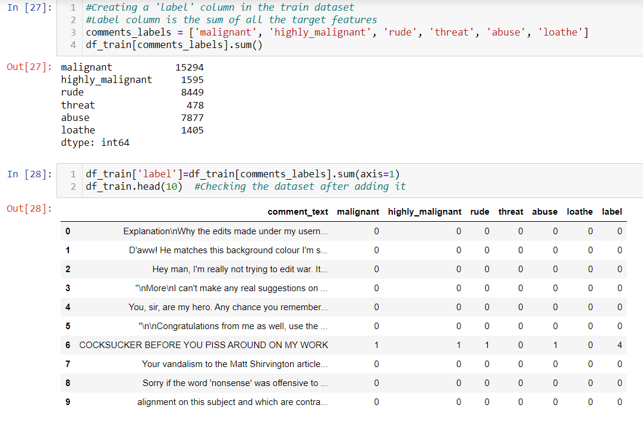
Data pre-processing
1
Dropping the Column
Due to the wide range of given data, it is extremely fruitful to clean, shape and set the data in the most suitable form. Dropping unnecessary columns declines the chances of producing errors. Thus, column ‘ID’ was dropped from the train dataset as every comment has its own unique id. After dropping the same, the dataset is now having 7 attributes in total including the target variables.

Slide 12
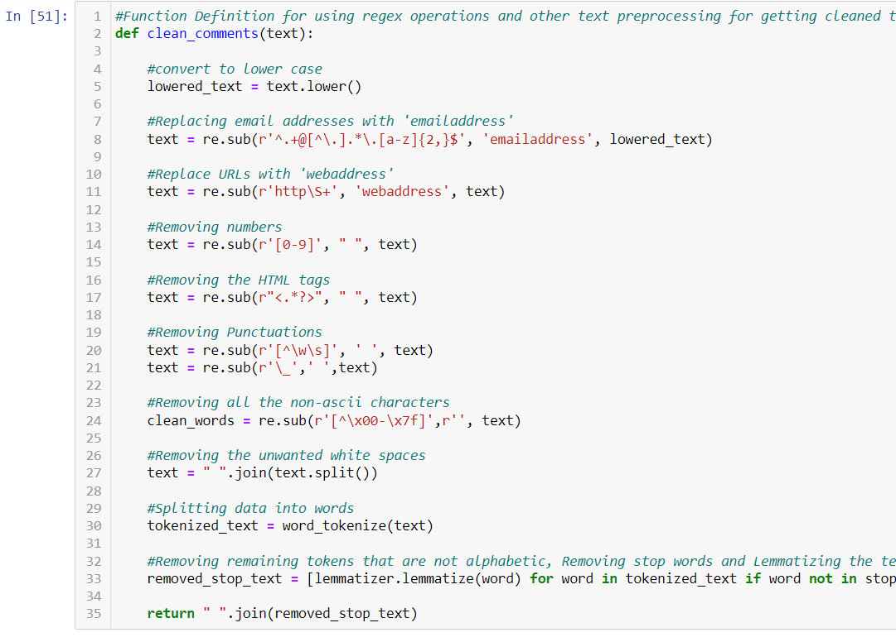
Cleaning the data using NLP
Replaced the extra lines or ‘\n’ from the text.
● Transform the text into lower case.
● Replaced the email addresses with the text 'emailaddress'
● Replaced the URLs with the text 'webaddress'
● Removed the numbers
● Removed the HTML tags
● Removed the punctuations
● Removed all the non-ascii characters
● Removed the unwanted white spaces
● Removed the remaining tokens that are not alphabetic
● Removed the stop words

Slide 13
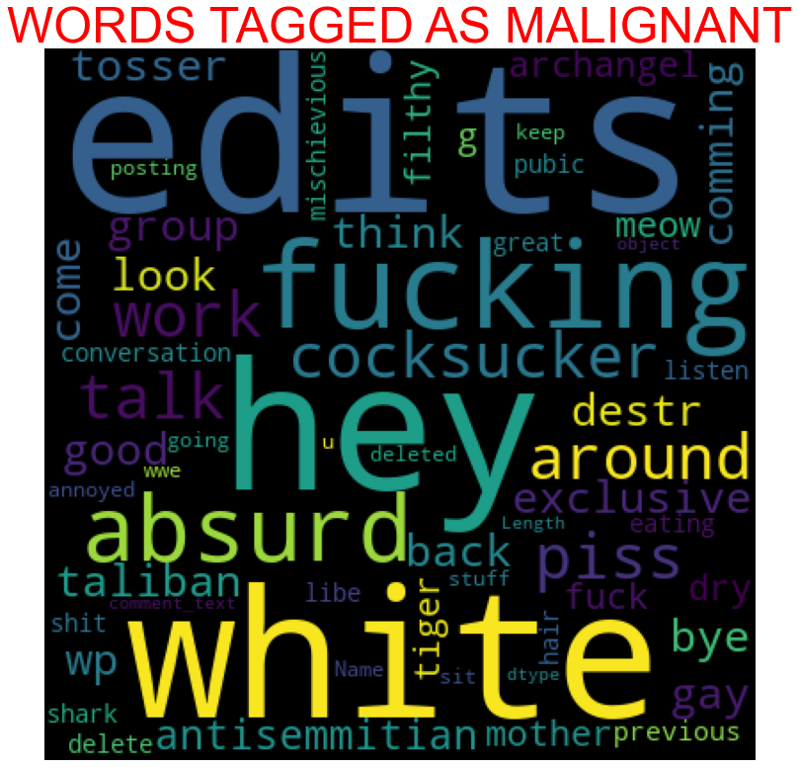
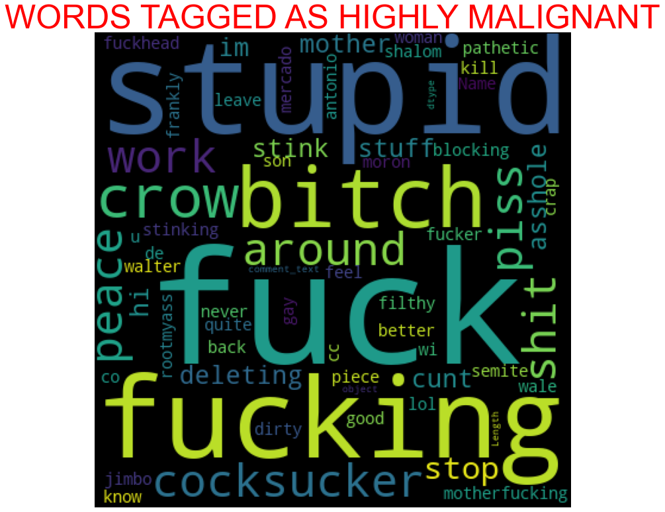
Plotting word-cloud for each feature

Slide 14
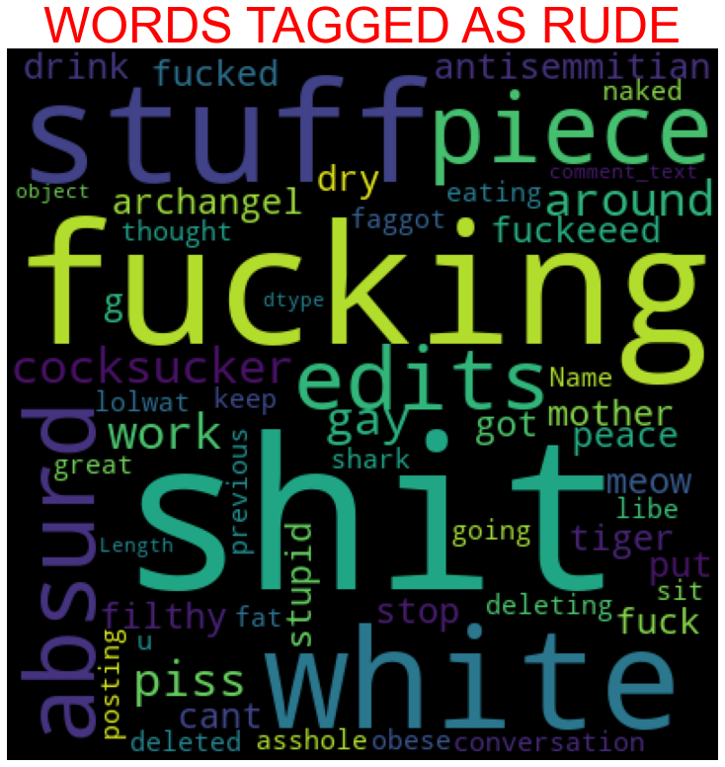
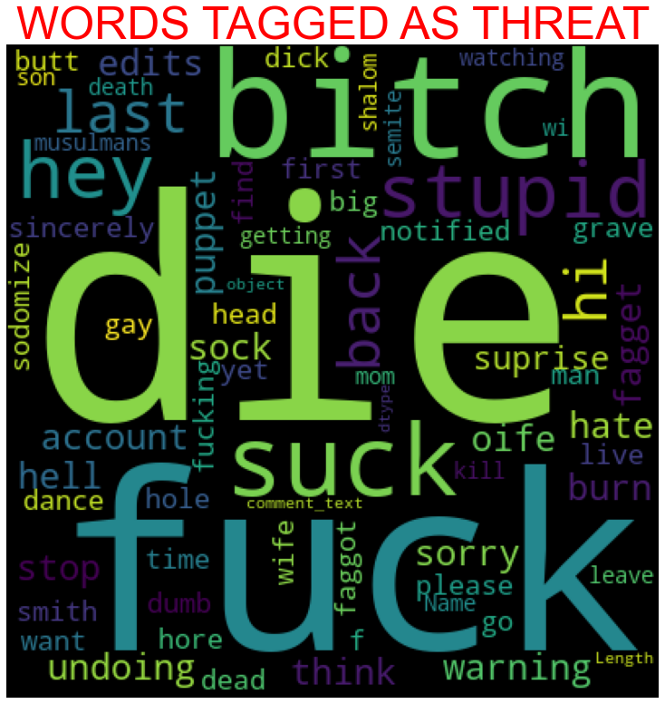
Plotting word-cloud for each feature

Slide 15
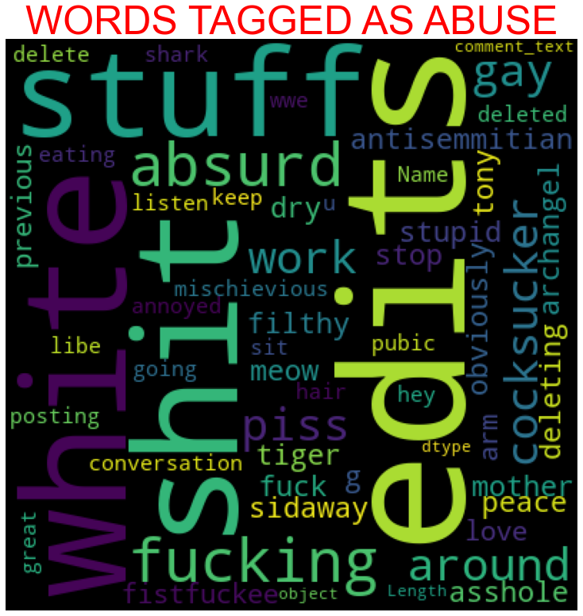
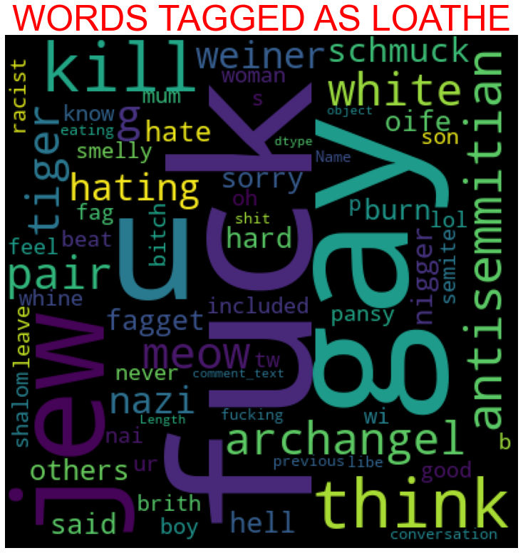
Plotting word-cloud for each feature

Slide 16
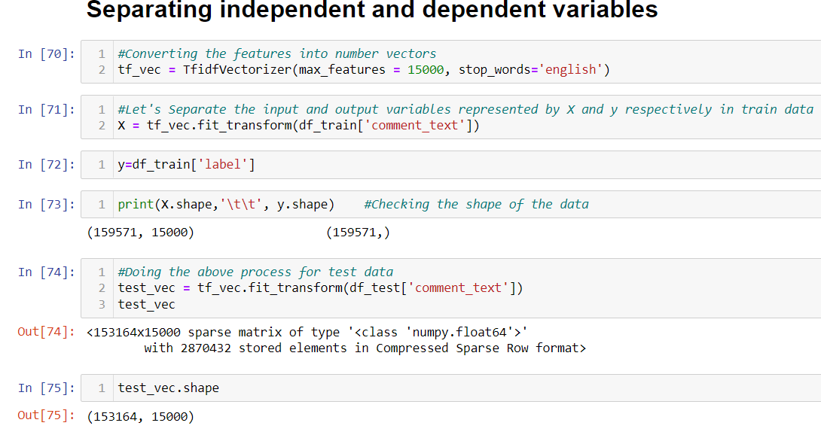
MODEL/S DEVELOPMENT AND EVALUATION
Separating independent and dependent features and converting the data into number features using Vectorizer

Slide 17
Building the model
The best 2 models performed well were Random Forest and their outputs are shown as follows:

Slide 18
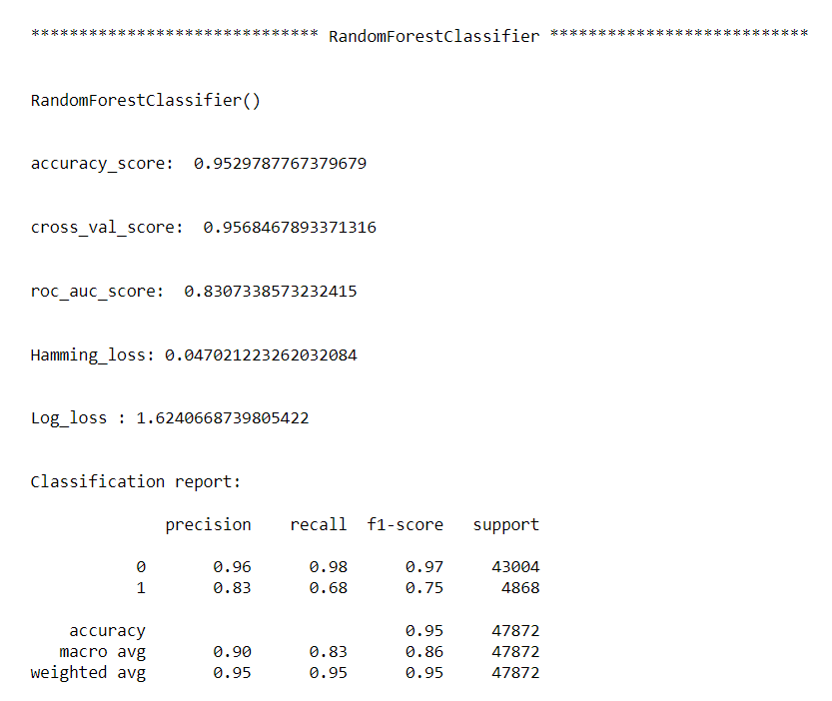
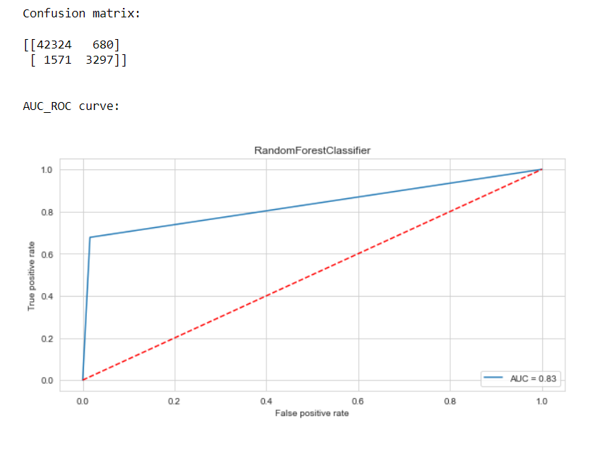

Slide 19
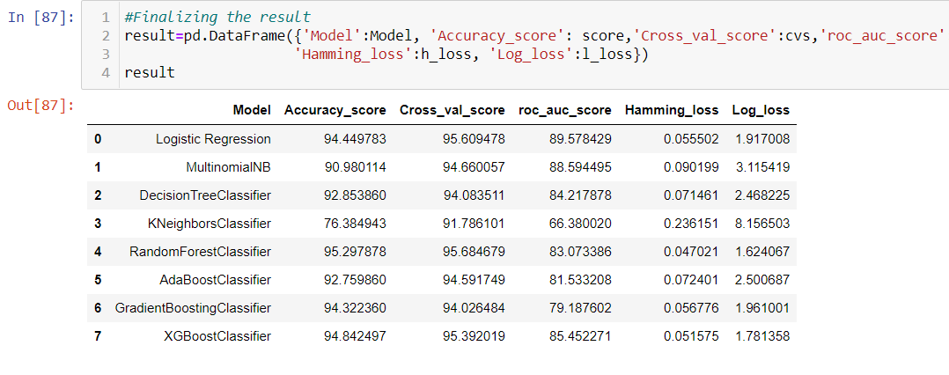
Final Result in a dataframe
After running the for loop of classification algorithms and the required metrics, we can see that the best 2 performing algorithms are RandomForestClassifier because the loss values are less and their scores are the best among all. Now, we will try Hyperparameter Tuning to find out the best parameters and using them to improve the scores and metrics values.

Slide 20
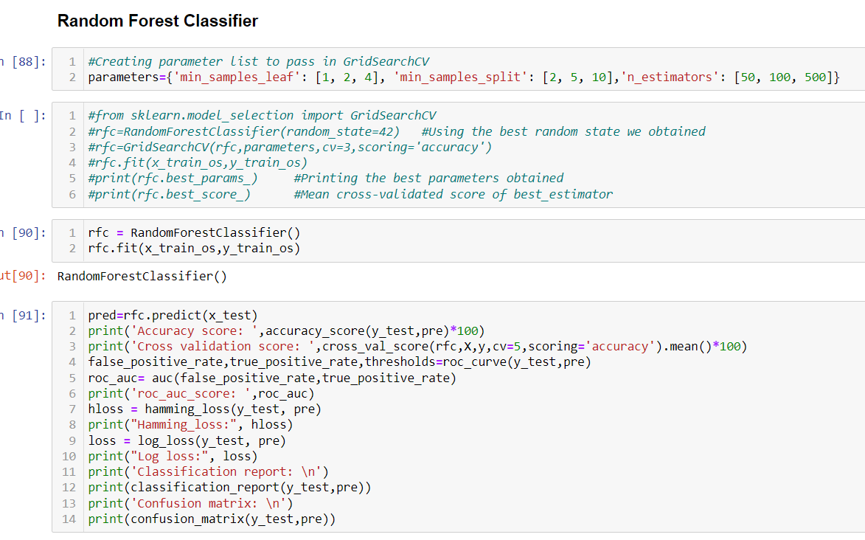
Hyperparameter Tuning
Accuracy score: 94.84249665775401
Cross validation score: 95.6759055707
roc_auc_score: 0.8545227051550955 Hamming_loss: 0.05157503342245989
Log loss: 1.7813583731865006
Classification report:
precision recall f1-score support 0 0.97 0.97 0.97 43004
1 0.75 0.74 0.74 4868 accuracy 0.95 47872 macro avg 0.86 0.85 0.86 47872 weighted avg 0.95 0.95 0.95 47872
Confusion matrix: [[41817 1187]
[ 1282 3586]]

Slide 21
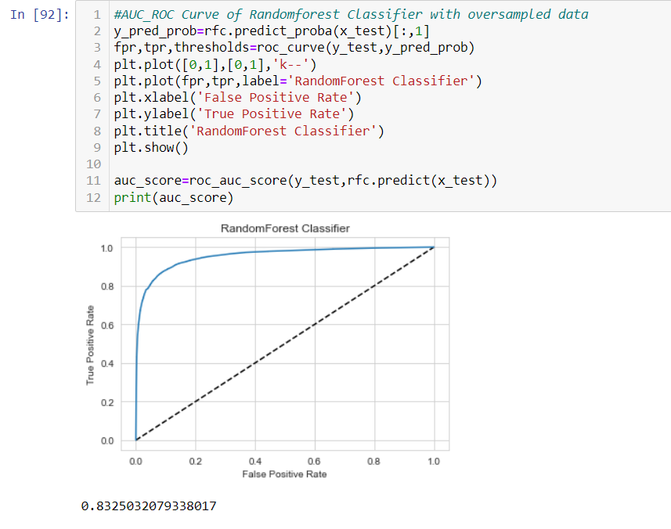
Plotting AUC_ROC Curve

Slide 22
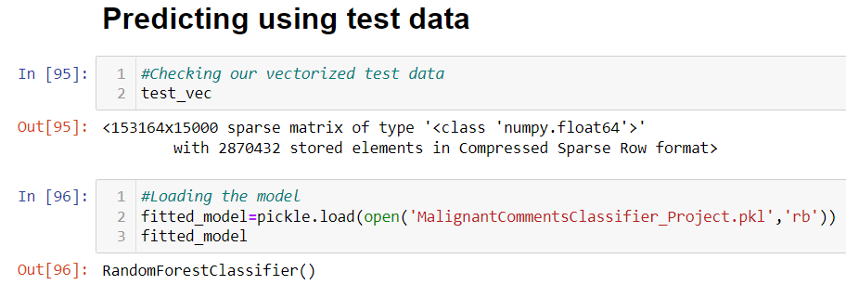
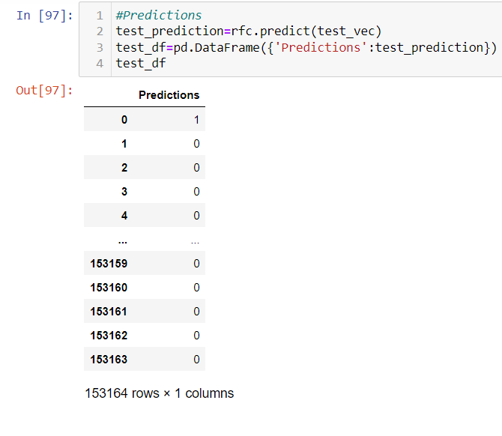
Predictions using test data
After predicting using test data, we will store the results in a csv file.

Slide 23
CONCLUSION
After the completion of this project, we got an insight of how to preprocess the data, analysing the data and building a model.
First, we imported both training and testing data, which had nearly 150000+ records.
We did all the required pre-processing steps like checking null values, datatypes check, dropping unnecessary columns, etc.
We used the training data for doing Exploratory Data Analysis using various plots and recorded the observations.
While observing the results, we found that the dataset was in highly imbalanced side and we need to handle it, in order to avoid overfitting problem.
Using NLP, we pre-processed the comment text and did other steps.
As the problem was a multi-class classifier, we took a new feature known as label and combined the comment_labels output together using sum() and then stored in that feature. For a binary classification problem, we scaled the data accordingly.
After applying Tf-idf Vectoriser, we used an oversampling technique called RandomOverSampler for handling the imbalanced data. There, we took 75% of the high points data and sampled it to the low points data so that both weights could be balanced equally and we could get proper result.

Slide 24
Thank You!

